Slide 1


Simon Hunt
12/08/2022

Slide 2
Outline
Executive Summary
Introduction
Methodology
Results
Conclusion
Appendix

Slide 3
Executive Summary
Summary of methodologies
Data Collection via API
Data Collection using Web Scraping
Data Wrangling
Exploratory Data Analysis with SQL
Exploratory Data Analysis including Data Visualization
Interactive Visual Analytics via Folium
Predictions with Machine Learning
Summary of all results
Results of Exploratory Data Analysis
Screenshots of Interactive Analytics
Results of Predictive Analytics

Slide 4
Introduction
Project background and context
SpaceX was founded in 2002 by Elon Musk. Elon Musk has proven to be very influential across a number of different technical-related areas since this time. SpaceX was formed with the vision that commercial flight could become obtainable within the not-too-distant future. In 2022, it is reported that a Falcon 9 cost stands ay $97 million dollars. This is a fraction of the cost that would be required to launch a Nasa rocket for example. One of the key reasons for the cost saving is due to the fact that the rocket can reuse the first stage. The goal of this project is to produce a machine learning pipeline that will predict the outcome of the landing of the first stage in the future.
Problems you want to find answers
What are the factors that will determine the successful landing of the rocket?
Identifying relationships between various variables and determine how it will affect the outcome.
Determining ideal conditions to ensure successful landing.

Slide 5
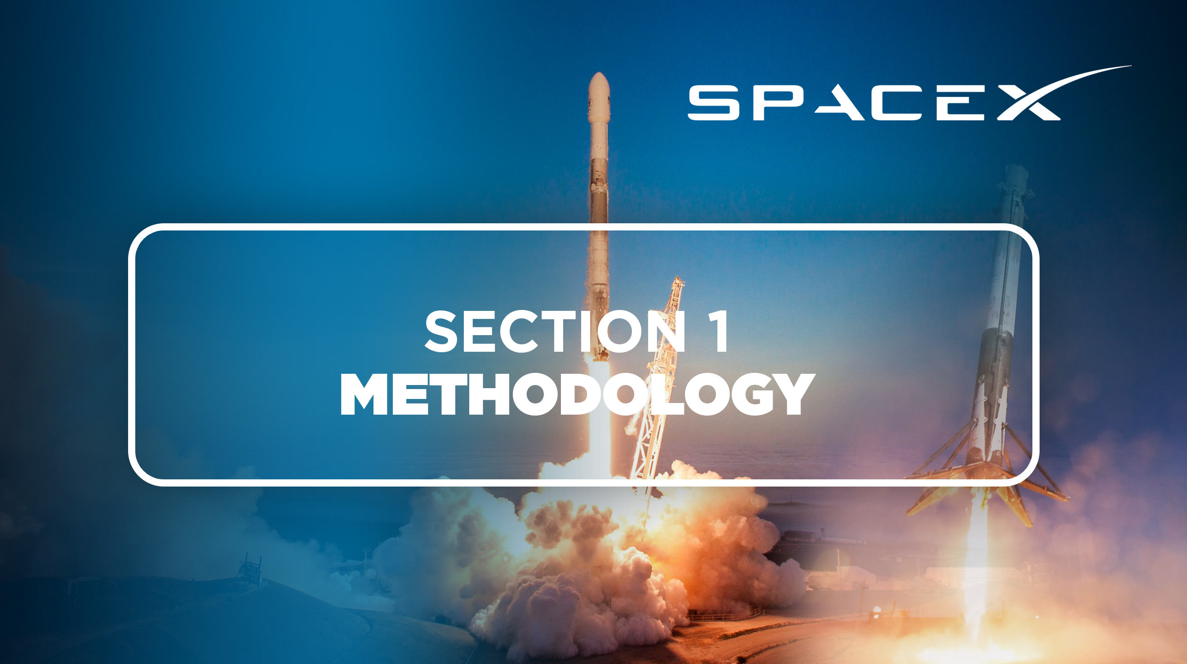

Slide 6
Methodology
Executive Summary
Data collection methodology:
In terms of how the data was collected, the SpaceX API was utilised in addition to web scraping Wikipedia (https://en.wikipedia.org/wiki/List_of_Falcon_9_and_Falcon_Heavy_launches)
Perform data wrangling
Filtering. One-Hot Encoding used to prepare the data.
Perform exploratory data analysis (EDA) using visualization and SQL
Perform interactive visual analytics using Folium and Plotly Dash
Perform predictive analysis using classification models
Building, fine tuning and evaluating classification models in order to achieve an optimum outcome.

Slide 7
Data Collection
To serve as an introduction, the process of data collection was used to collect and measure information obtained from a specified system. This was achieved using a combination of web scraping from SpaceX’s Wikipedia page, along with API request via the SpaceX REST API.
REST API: The GET request was used, followed by decoding the response content as Json. The data was then cleaned, and missing values were identified. Missing values were populated where required.
WEB SCRAPING: Web scraping was performed via the Wikipedia entry pertaining to Falcon 9 launch records (using Beautiful Soup to extract the required records).
The collection of data via both of these methods allowed for a deeper analysis of data.

Slide 8
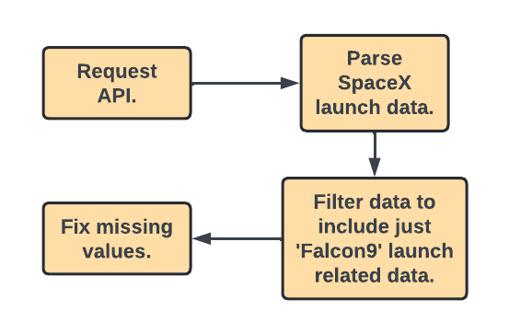
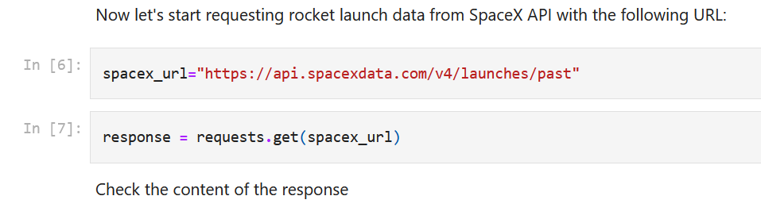
Data Collection – SpaceX API
In order to achieve this, the SpaceX API was used to collect the data (this data is publicly available). Please see flow chart to the right. The data was cleaned, and formatting and data wrangling operations were performed.
GitHub URL: https://github.com/simonhunt1/SPACE-X-IBM-PROJECT-/blob/main/WEEK-1_%20DATA%20COLLECTION%20API.ipynb
Requesting data:

Slide 9
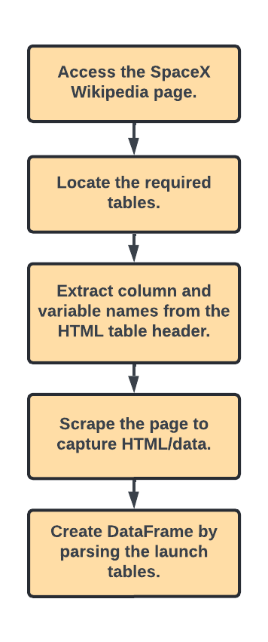
Data Collection - Scraping
Wikipedia was utilised as a source of data in relation to SpaceX launches. The tables from the Wikipedia entry were scraped by utilising BeautifulSoup, and converted into a Pandas DataFrame. The flowchart to the right details the process.
GitHub URL: https://github.com/simonhunt1/SPACE-X-IBM-PROJECT-/blob/main/WEEK-1_%20DATA%20COLLECTION%20%2B%20WEB%20SCRAPING.ipynb

Slide 10
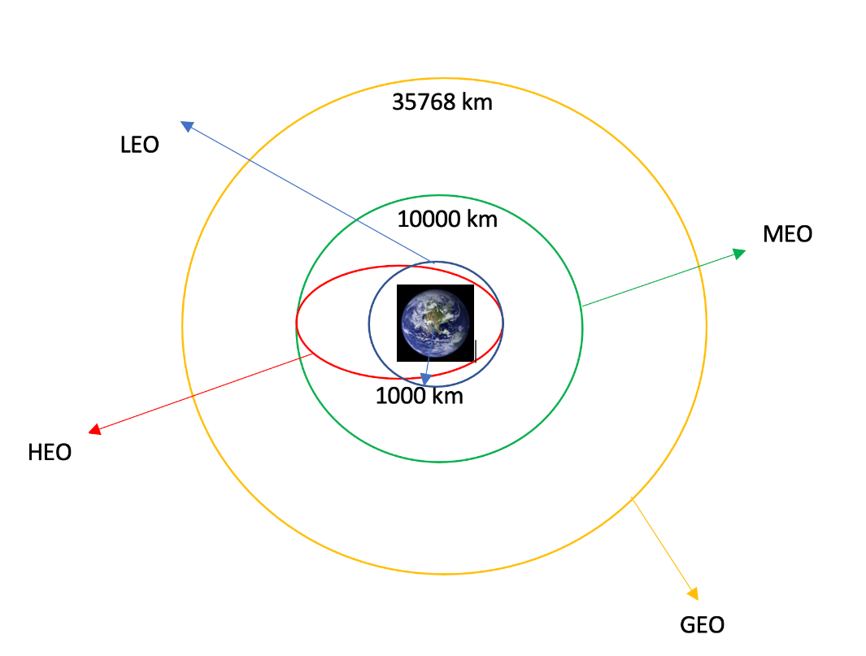
Data Wrangling
To begin, Exploratory Data Analysis was performed on the data set. Launch per site summaries, orbit occurrences and mission outcomes per type of orbit were then calculated. The landing outcome label was then created. I then created a landing outcome label and exported the results as a CSV file.
GitHub URL: https://github.com/simonhunt1/SPACE-X-IBM-PROJECT-/blob/main/WEEK-1_%20DATA%20WRANGLING.ipynb

Slide 11
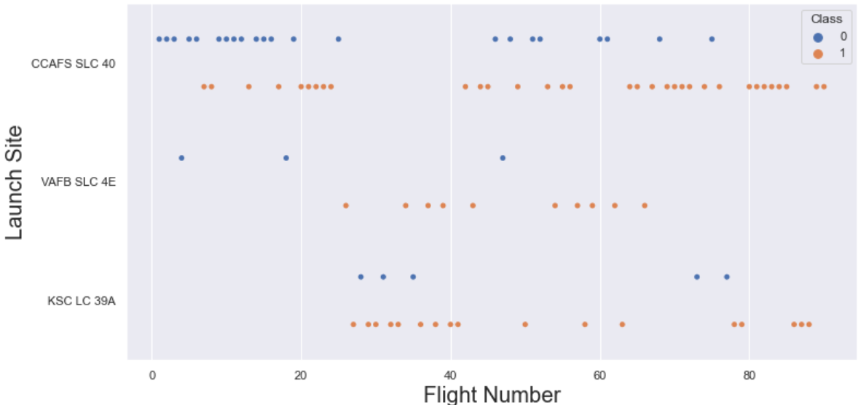
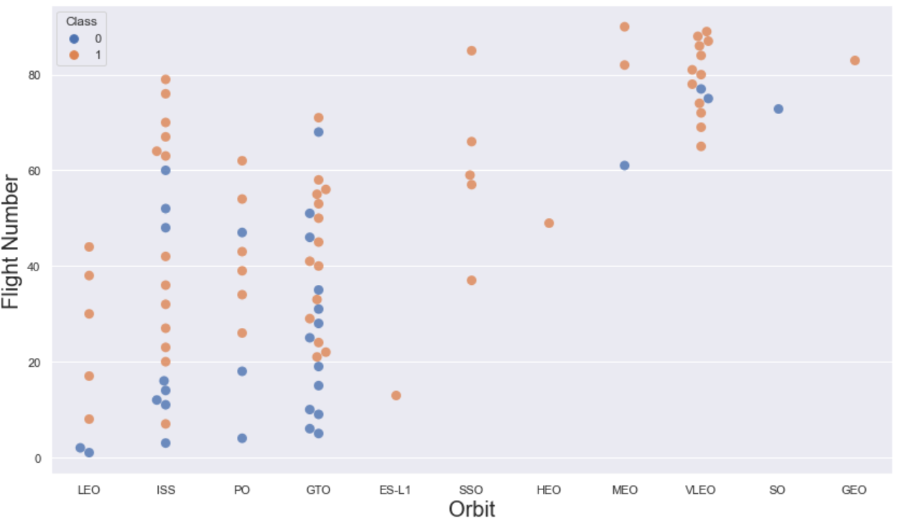
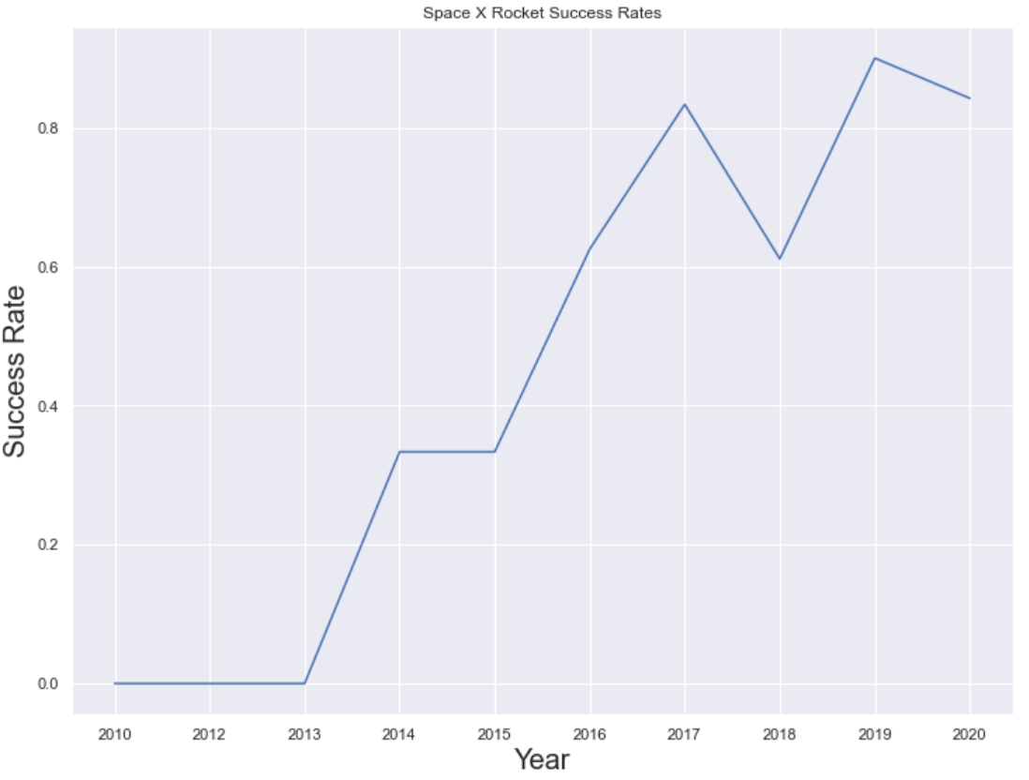
EDA with Data Visualization
The following charts were created:
Flight Number vs. Payload Mass, Flight Number vs. Launch Site, Payload Mass vs. Launch Site, Orbit Type vs. Success Rate, Flight Number vs. Orbit Type, Payload Mass vs. Orbit Type, Success Rate Yearly Trend
Scatter plots illustrate the relationships between variables. They are useful for identifying potential correlations, which can be incorporated into machine learning models. Bar charts compare different discrete categories, highlighting the relationships between these categories and specific measured values. Line charts depict trends over time, providing a clear view of how data changes across a timeline.
GitHub URL: https://github.com/simonhunt1/SPACE-X-IBM-PROJECT-/blob/main/WEEK-2_%20EDA%20WITH%20VISUALISATION.ipynb

Slide 12
EDA with SQL
Executed SQL queries included:
Retrieving the unique launch site names from space missions
Displaying five records with launch sites starting with 'CCA’
Calculating the total payload mass for boosters launched by NASA (CRS)
Finding the average payload mass for booster version F9 v1.1
Identifying the date of the first successful ground pad landing
Listing boosters that successfully landed on a drone ship with payload masses between 4000 and 6000
Counting the total number of successful and failed mission outcomes
Listing the booster versions that carried the maximum payload massReporting the failed drone ship landings, their booster versions, and launch site names for 2015
Ranking landing outcomes (e.g., Failure on drone ship, Success on ground pad) from 2010-06-04 to 2017-03-20 in descending order
GitHub URL:
https://github.com/simonhunt1/SPACE-X-IBM-PROJECT-/blob/main/WEEK-2_%20DATA%20ANALYSIS%20USING%20SQL.ipynb

Slide 13
Build an Interactive Map with Folium
Markers for All Launch Sites:
Placed a marker with a circle, popup label, and text label for NASA Johnson Space Centre using its latitude and longitude coordinates as the starting location.
Placed markers with circles, popup labels, and text labels for all launch sites using their latitude and longitude coordinates to display their geographical locations and proximity to the equator and coasts.
Coloured Markers for Launch Outcomes at Each Site:
Added coloured markers to indicate successful (Green) and failed (Red) launches using a Marker Cluster to highlight which launch sites have higher success rates.
Distances from a Launch Site to Nearby Locations:
Added coloured lines to illustrate the distances from Launch Site KSC LC-39A (as an example) to nearby locations such as a railway, highway, coastline, and the closest city.
GitHub URL:
https://github.com/simonhunt1/SPACE-X-IBM-PROJECT-/blob/main/WEEK-3_%20INTERACTIVE%20VISUAL%20ANALYTICS.ipynb

Slide 14
Build a Dashboard with Plotly Dash
Launch Sites Dropdown Menu:
Implemented a dropdown menu to allow for the selection of different launch sites.
Pie Chart Displaying Successful Launches (All Sites/Specific Site):
Included a pie chart to illustrate the total count of successful launches across all sites, and the Success vs. Failed counts for a selected launch site.
Payload Mass Range Slider:
Introduced a slider to adjust the payload mass range.
Scatter Plot of Payload Mass vs. Success Rate for Various Booster Versions:
Created a scatter plot to display the relationship between payload mass and launch success rates across different booster versions.
GitHub URL:
https://github.com/simonhunt1/SPACE-X-IBM-PROJECT-/blob/main/SPACEX%20APP.py

Slide 15
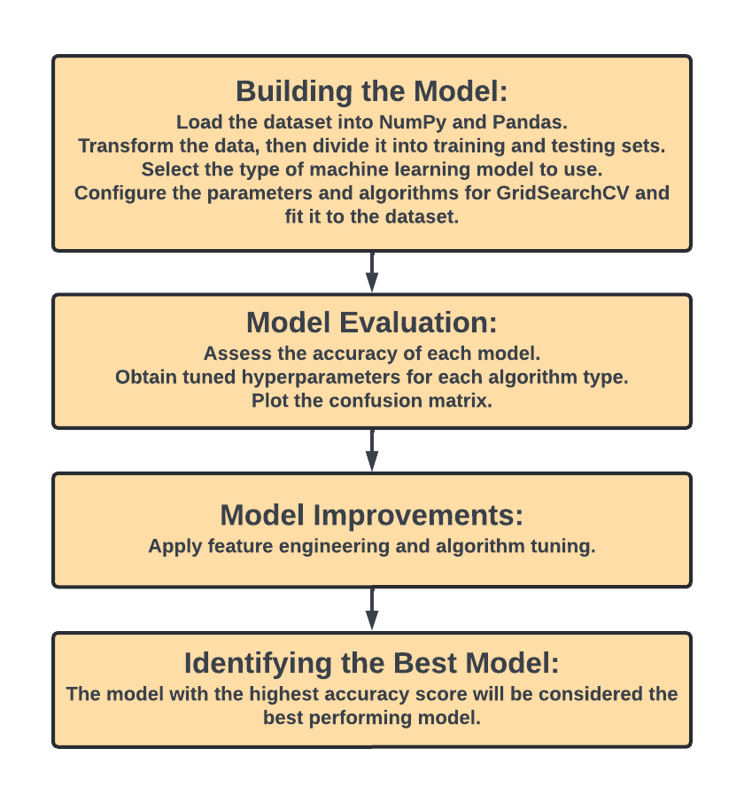
Predictive Analysis (Classification)
GitHub URL:
https://github.com/simonhunt1/SPACE-X-IBM-PROJECT-/blob/main/SPACEX%20APP.py

Slide 16
Results
The below represents how the results will be categorised and presented:
Exploratory data analysis results
Interactive analytics demo in screenshots
Predictive analysis results

Slide 17
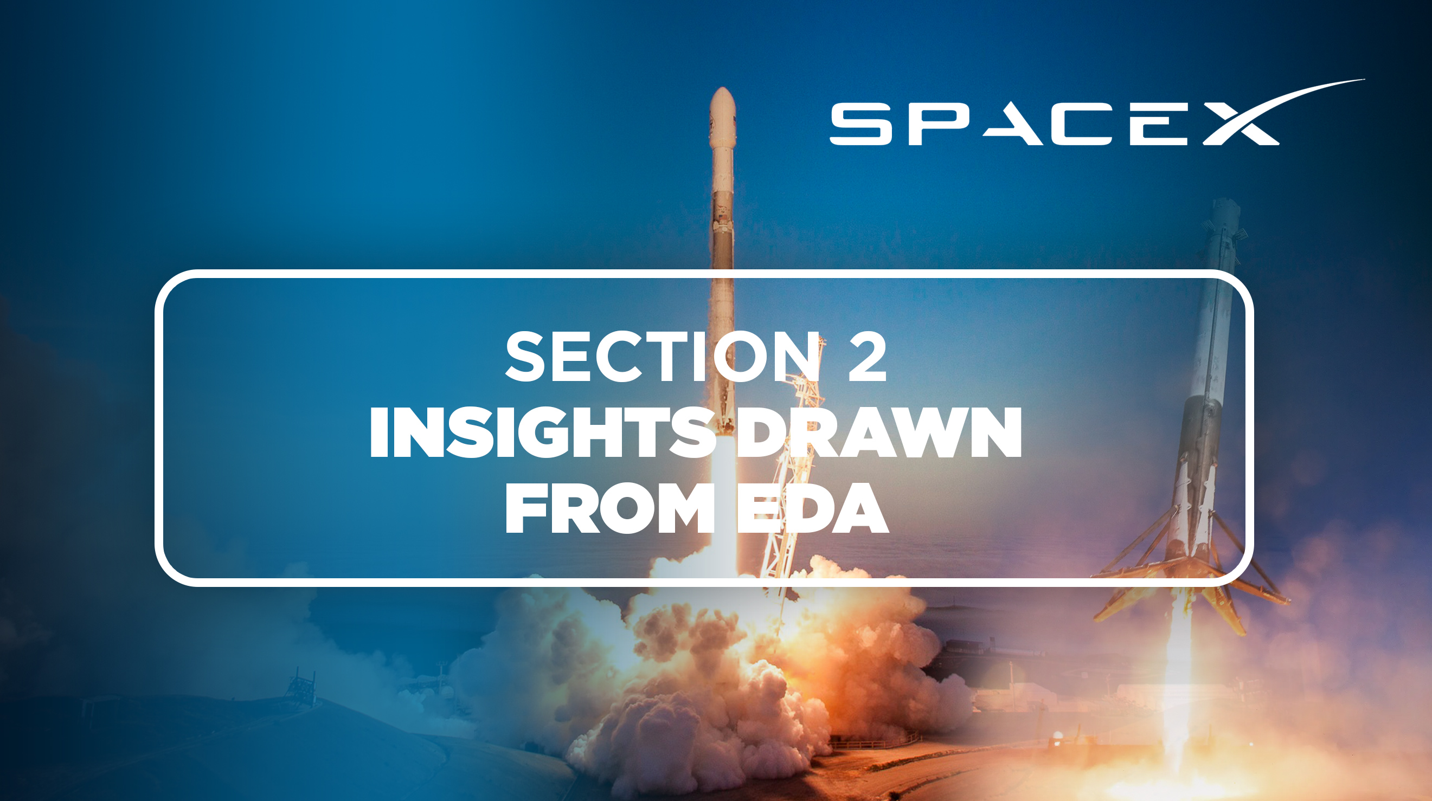

Slide 18
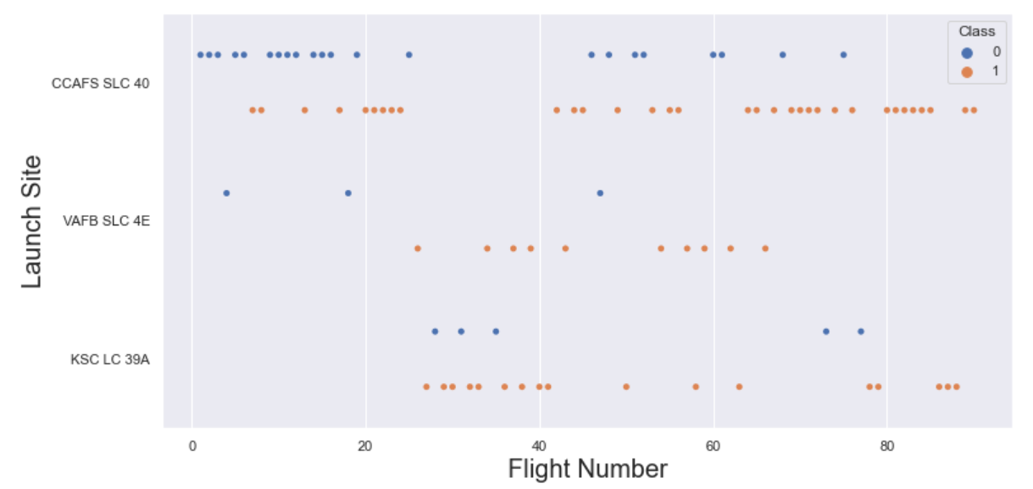
Flight Number vs. Launch Site
This scatter plot indicates a correlation between the number of flights from a launch site and its success rate—the more flights, the higher the success rate. However, the CCAFS SLC40 site deviates from this pattern, showing the weakest correlation.

Slide 19
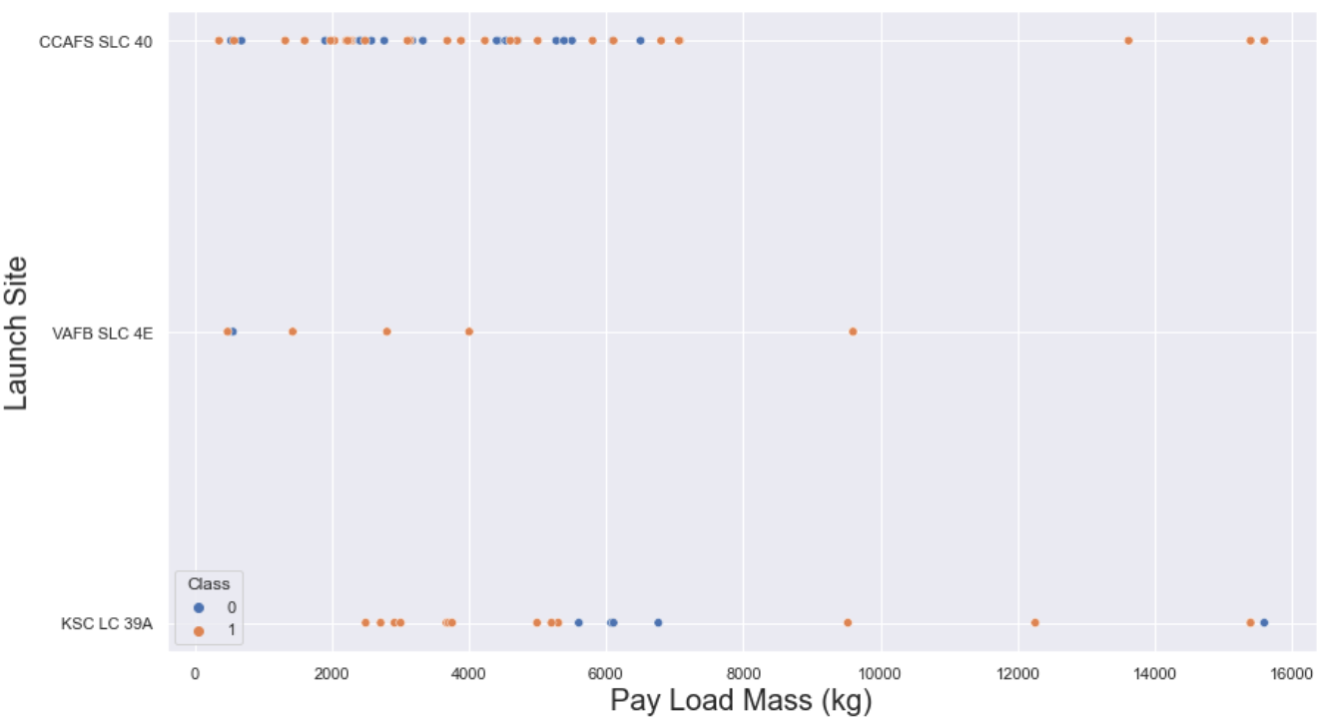
Payload vs. Launch Site
This scatter plot demonstrates that payloads exceeding 7000kg have a significantly higher probability of successful launches. However, there is no evident pattern suggesting that the success rate is influenced by the launch site based on payload mass.

Slide 20
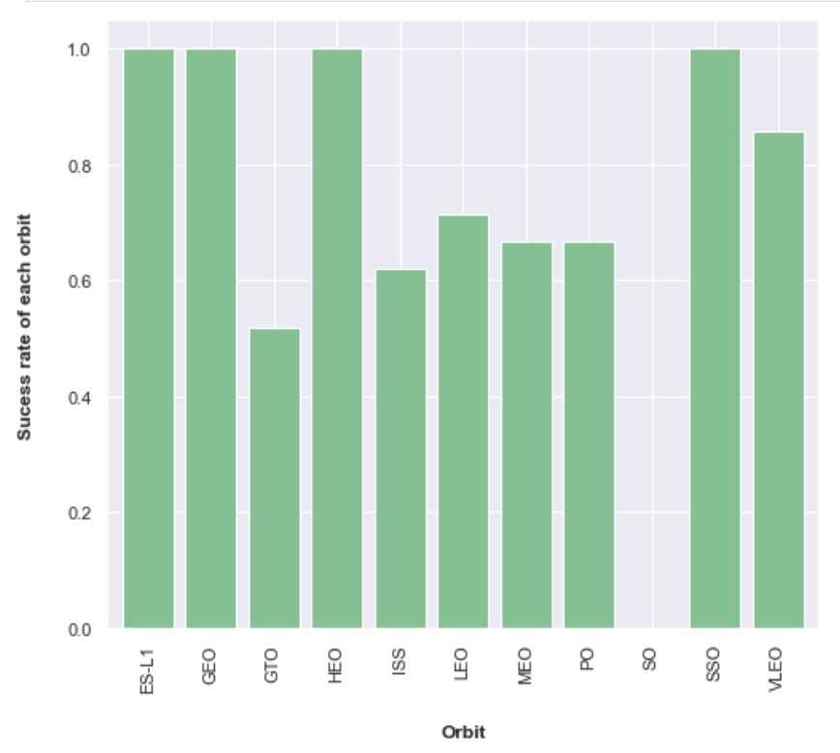
Success Rate vs. Orbit Type
This figure illustrates the impact of different orbits on landing outcomes. Certain orbits, such as SSO, HEO, GEO, and ES-L1, have a 100% success rate, while the SO orbit has a 0% success rate. However, a closer examination reveals that some orbits, like GEO, SO, HEO, and ES-L1, only have a single occurrence. This indicates that more data is required to identify any patterns or trends before drawing definitive conclusions.

Slide 21
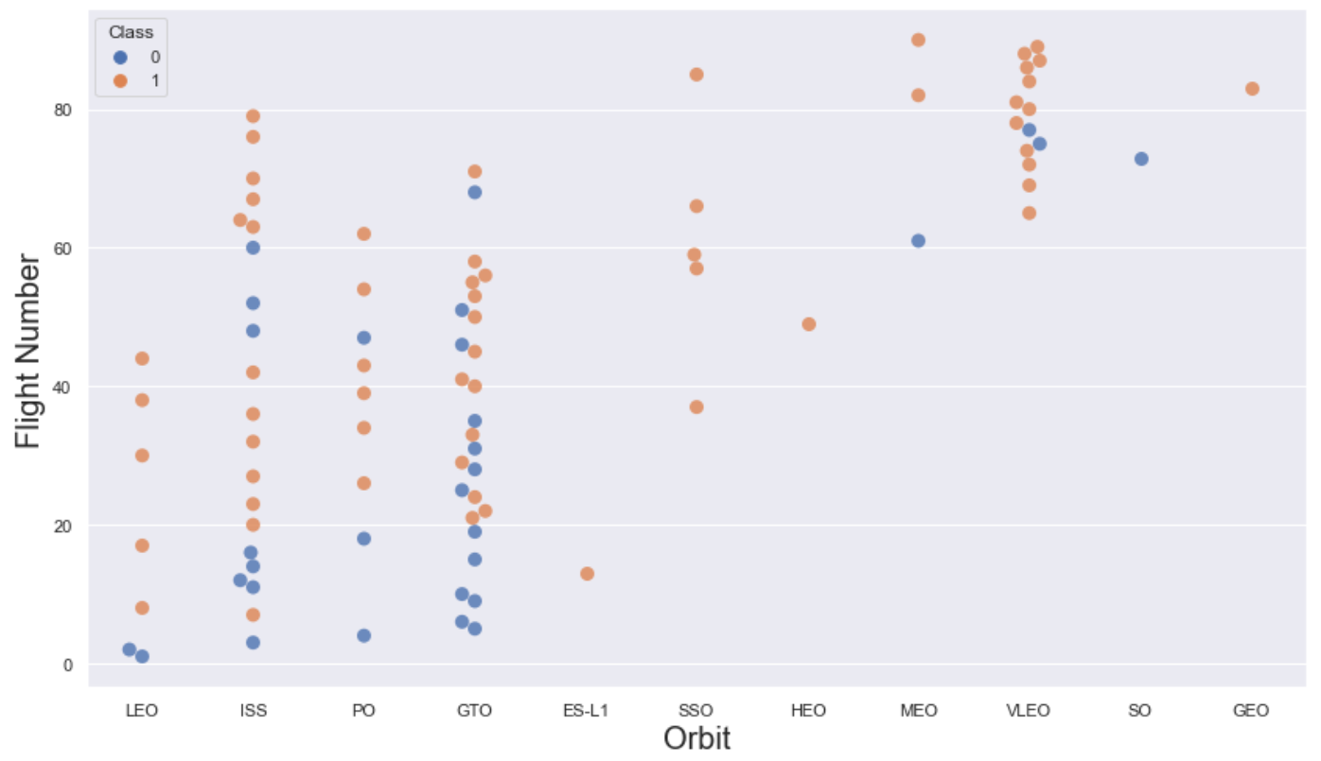
Flight Number vs. Orbit Type
This scatter plot demonstrates that, in general, higher flight numbers correlate with increased success rates for each orbit, particularly for the LEO orbit. However, the GTO orbit shows no discernible relationship between these variables. Orbits with only one occurrence should be excluded from this analysis, as additional data is needed for a conclusive statement.

Slide 22
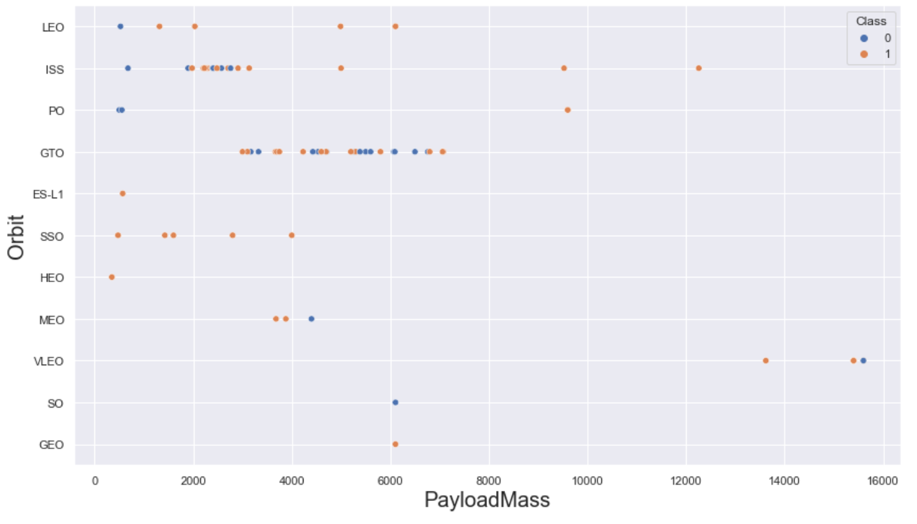
Payload vs. Orbit Type
Heavier payloads positively affect LEO, ISS, and P0 orbits. Conversely, they negatively impact MEO and VLEO orbits. For GTO orbit, no clear relationship between payload and success is evident. Additionally, SO, GEO, and HEO orbits require more data to identify any potential patterns or trends.

Slide 23

Launch Success Yearly Trend
As per the line graph, these figures clearly show an upward trend from 2013 to 2020.

Slide 24
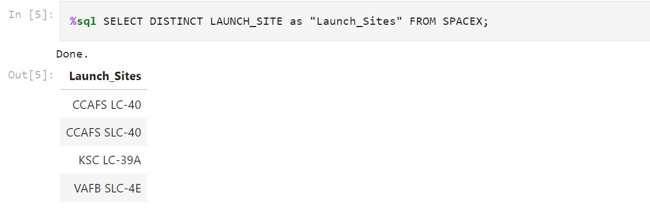
All Launch Site Names
I utilised the keyword DISTINCT to display only the unique launch sites from the SpaceX data.

Slide 25
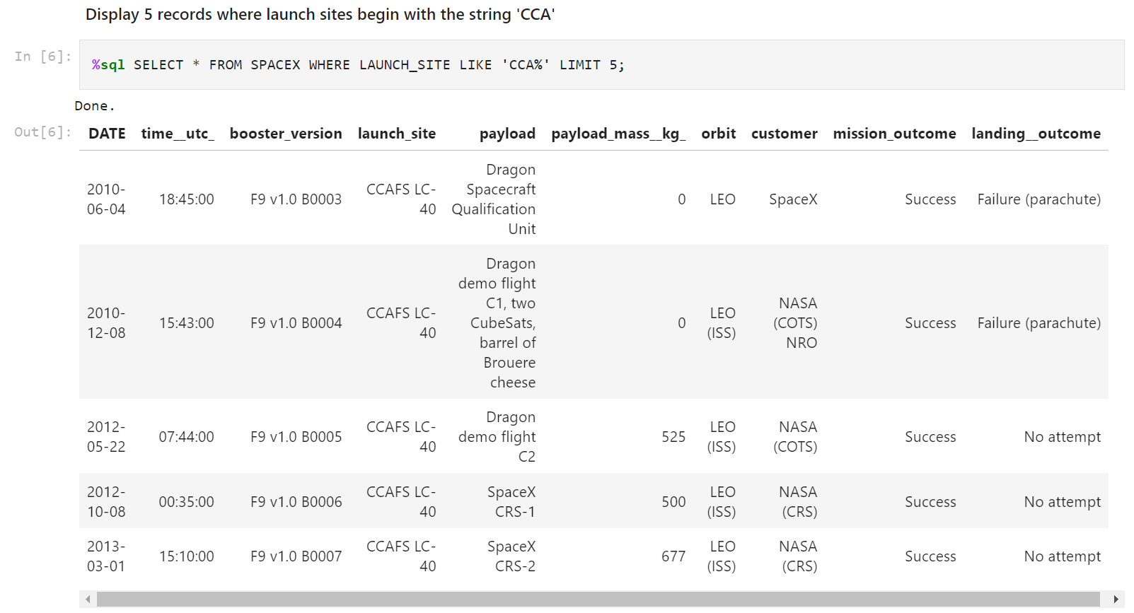
Launch Site Names Begin with 'CCA'
The below query was used to present the 5 records whereby launch sites begin with “CCA”.

Slide 26
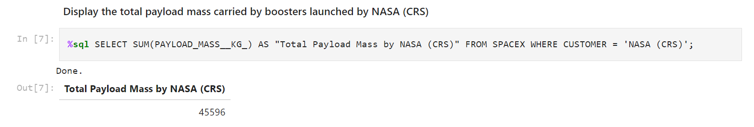
Total Payload Mass
The below query was utilised to calculate the total payload carried by boosters from NASA (45596).

Slide 27
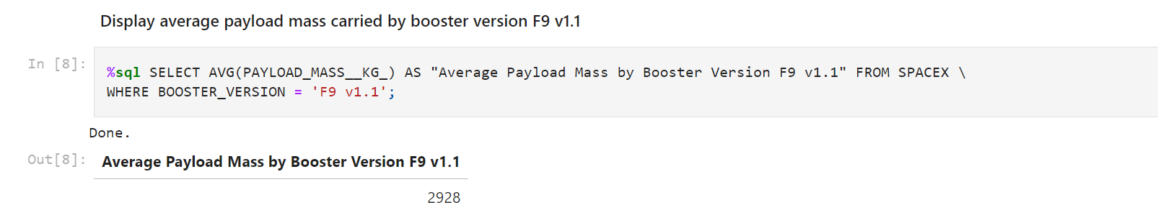
Average Payload Mass by F9 v1.1
The average payload mass carried by booster version F9 v1.1 was calculated to be 2928.4.

Slide 28
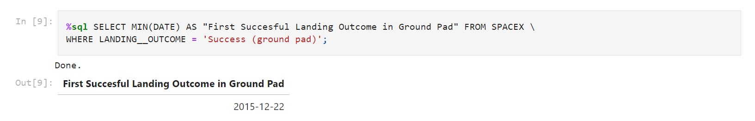
First Successful Ground Landing Date
I applied the min() function to determine the result and found that the date of the first successful landing on a ground pad was December 22, 2015

Slide 29
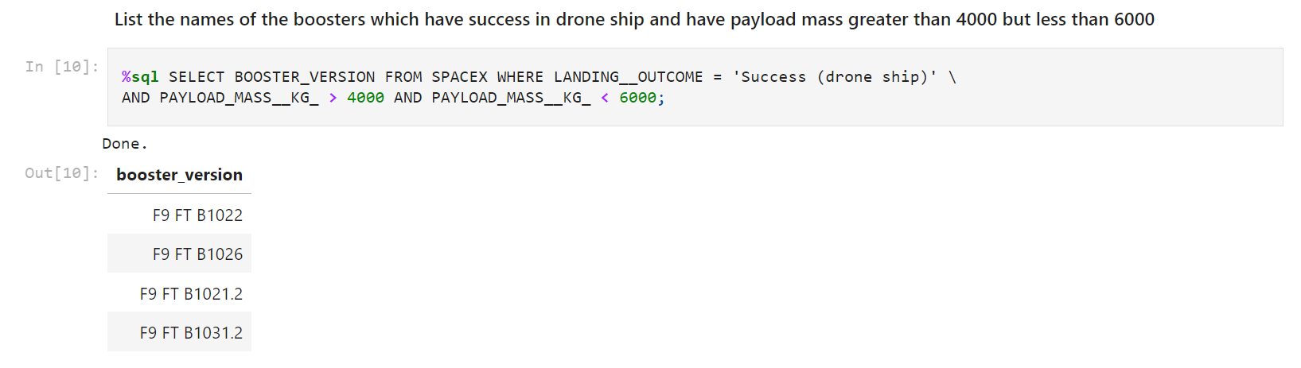
Successful Drone Ship Landing with Payload between 4000 and 6000
I utilised the WHERE clause to filter for boosters that successfully landed on a drone ship, and applied the AND condition to identify those with a payload mass greater than 4000 but less than 6000.

Slide 30
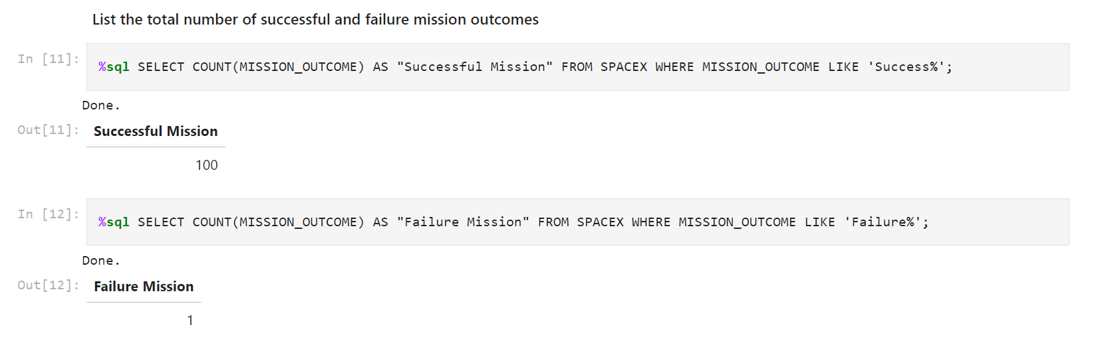
Total Number of Successful and Failure Mission Outcomes
Wildcard like ‘%’ was utilised to filter for WHERE MissionOutcome was a success or a failure.

Slide 31
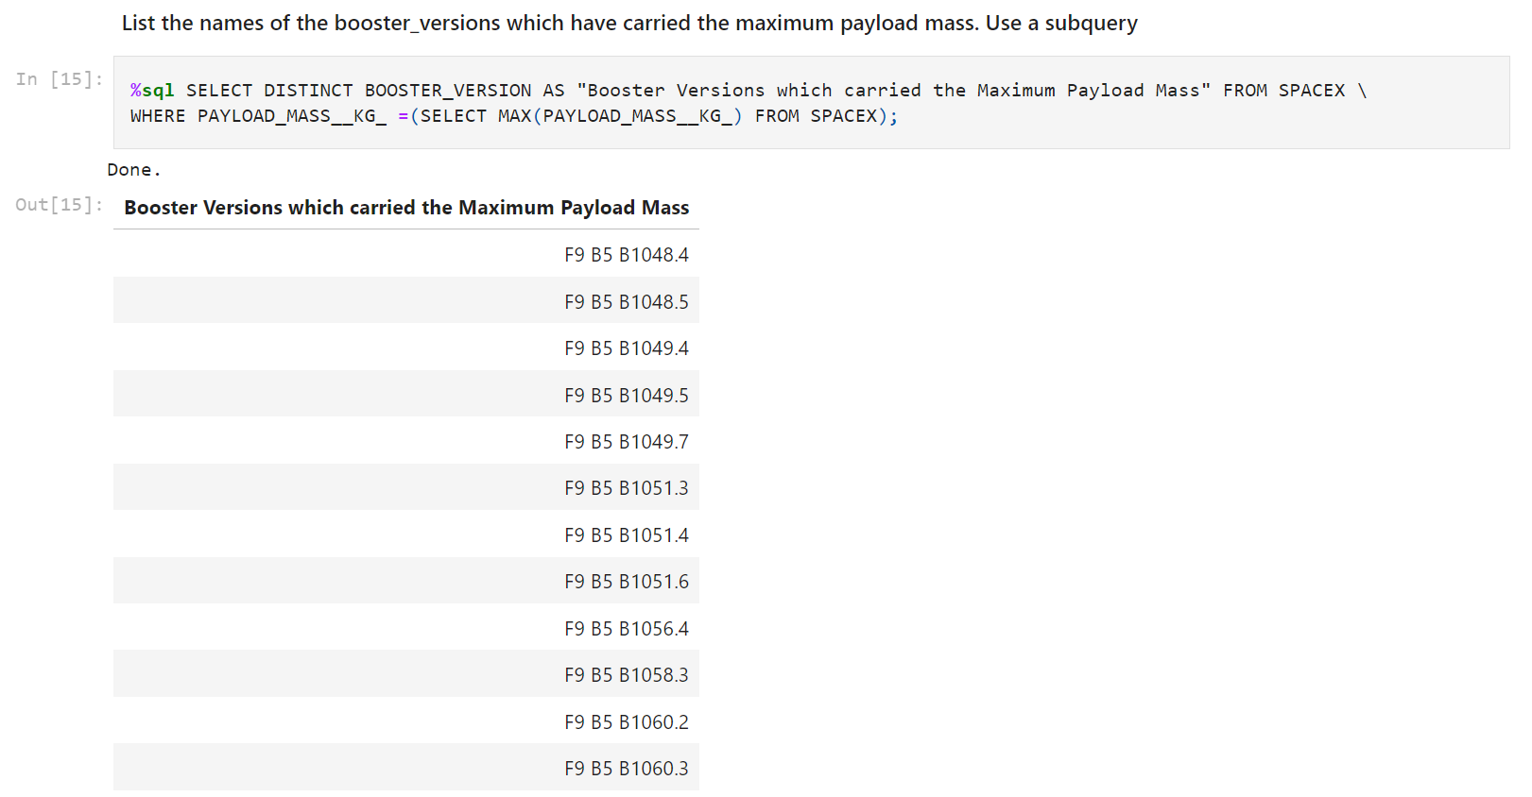
Boosters Carried Maximum Payload
I determined the booster that has carried the maximum payload by utilising subquery in the WHERE clause and the MAX() function.

Slide 32
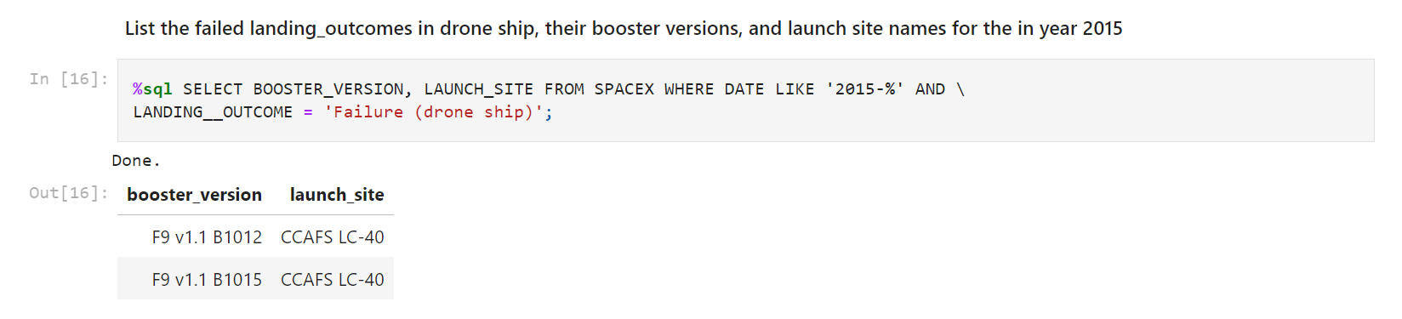
2015 Launch Records
I utilised a combination of the WHERE clause, LIKE, AND, and BETWEEN conditions to filter for failed landing outcomes on drone ships, along with their booster versions and launch site names for the year 2015.

Slide 33
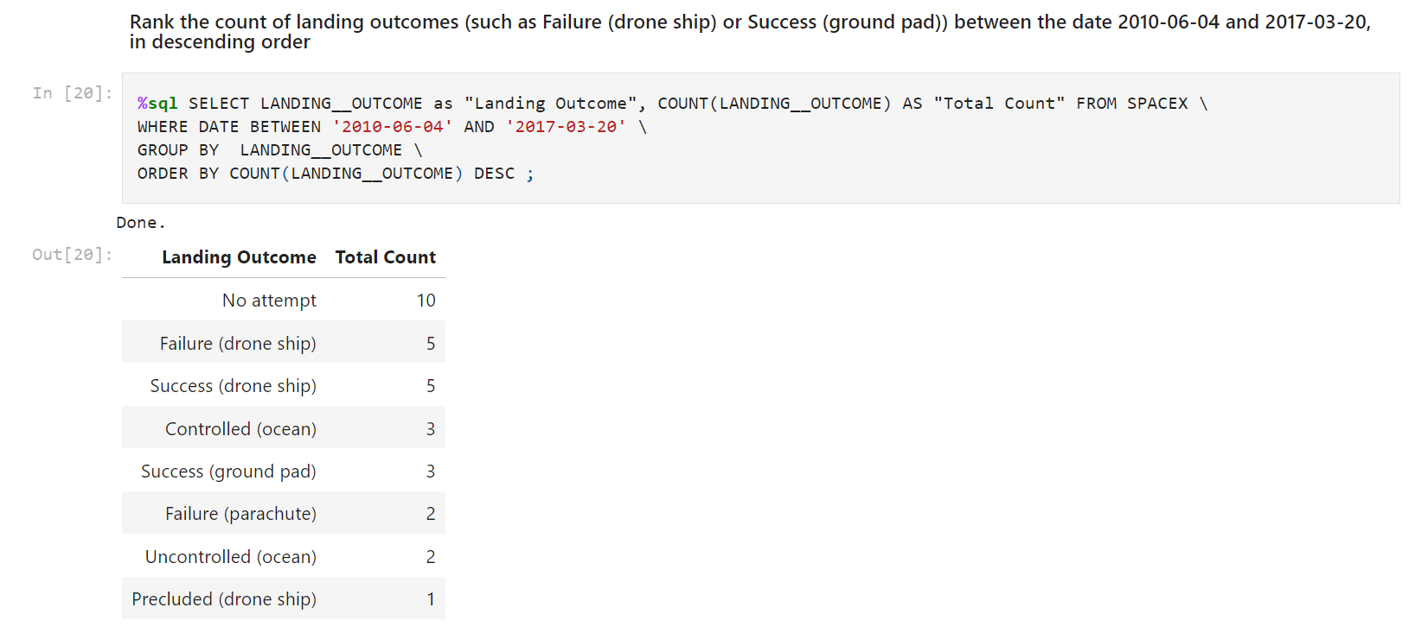
Rank Landing Outcomes Between 2010-06-04 and 2017-03-20
I extracted the landing outcomes and their counts from the data, using the WHERE clause to filter for outcomes between 2010-06-04 and 2010-03-20. We then applied the GROUP BY clause to categorise the landing outcomes, and the ORDER BY clause to sort these grouped outcomes in descending order.

Slide 34
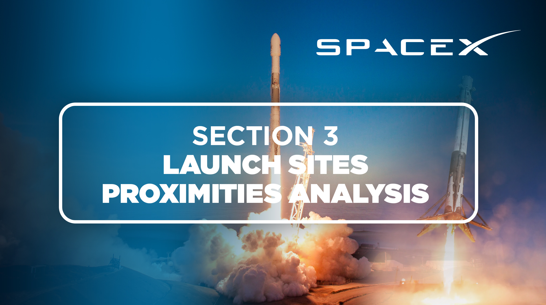

Slide 35
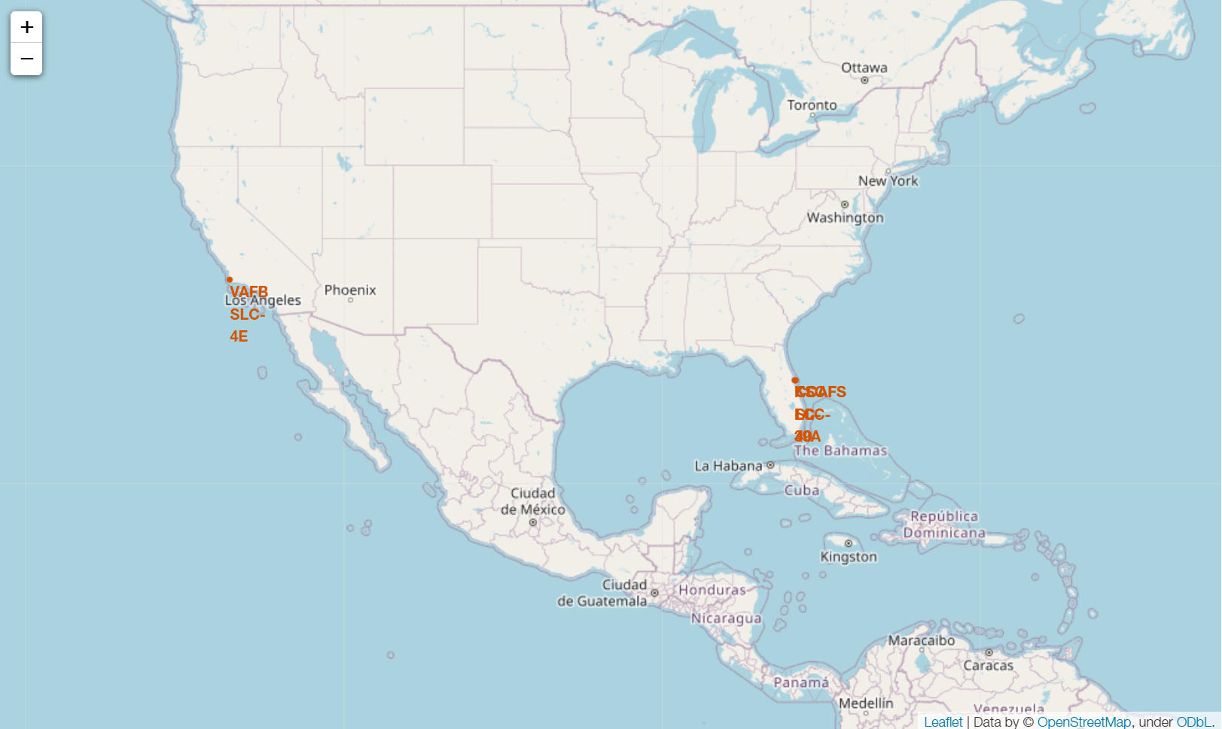
Map Of All Launch Site Locations
To the left we have a map of all launch sites locations (all located within the USA).

Slide 36
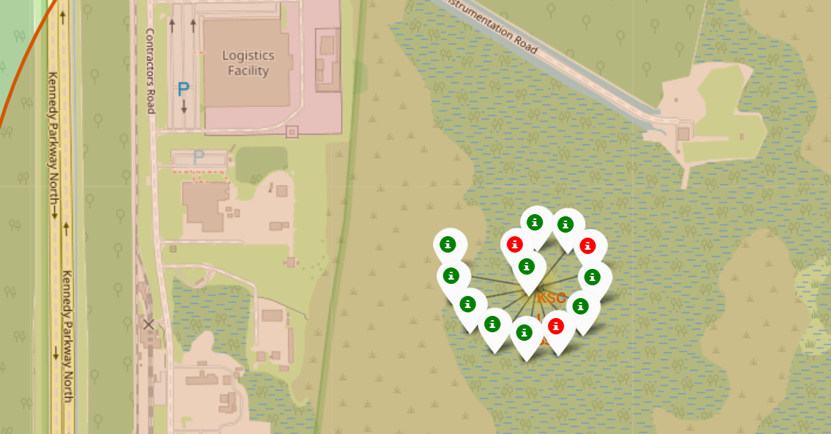
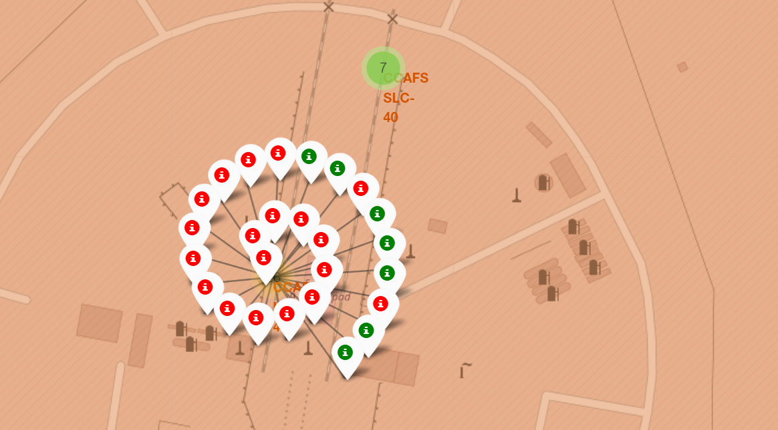
Launch Sites With Labels
The color-coded markers allow us to easily identify launch sites with relatively high success rates.
Green Markers: Successful Launch
Red Markers: Failed Launch

Slide 37
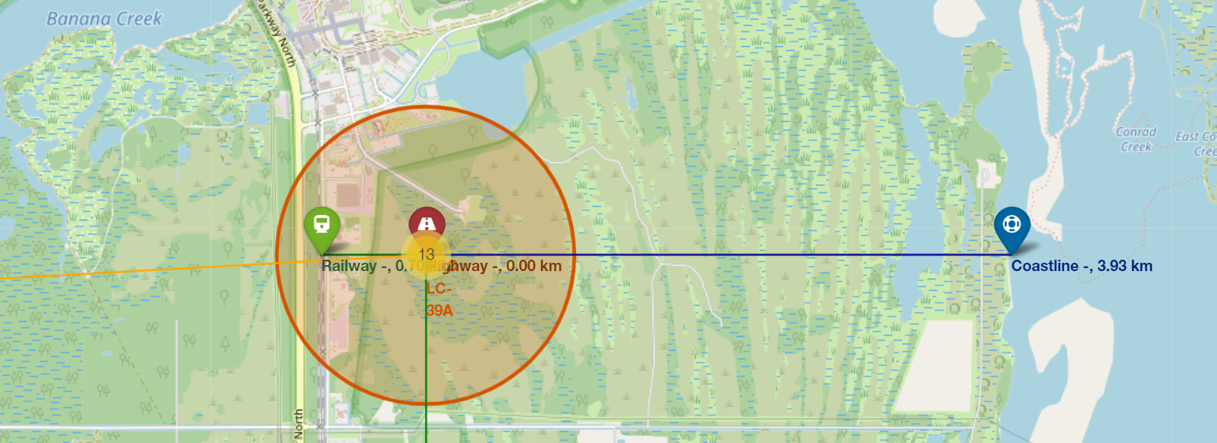
Distance To Landmarks From Launch Sites
From the visual analysis of launch site KSC LC-39A, it is evident that it is:
Very close to a railway (0.70 km)
Very close to a highway (0 km)
Fairly close to the coastline (3.93 km)
A failed rocket traveling at high speeds can cover vast distances in minimal times, with the very real possibility of serious damage to built-up areas.

Slide 38
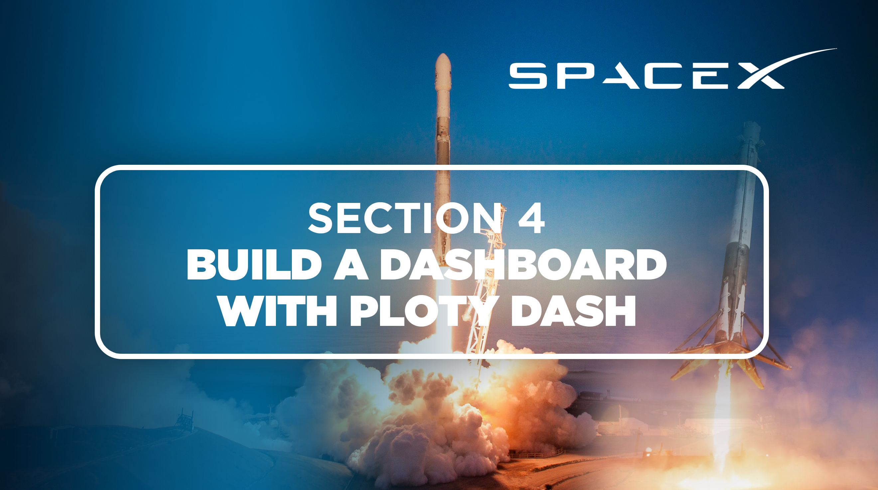

Slide 39
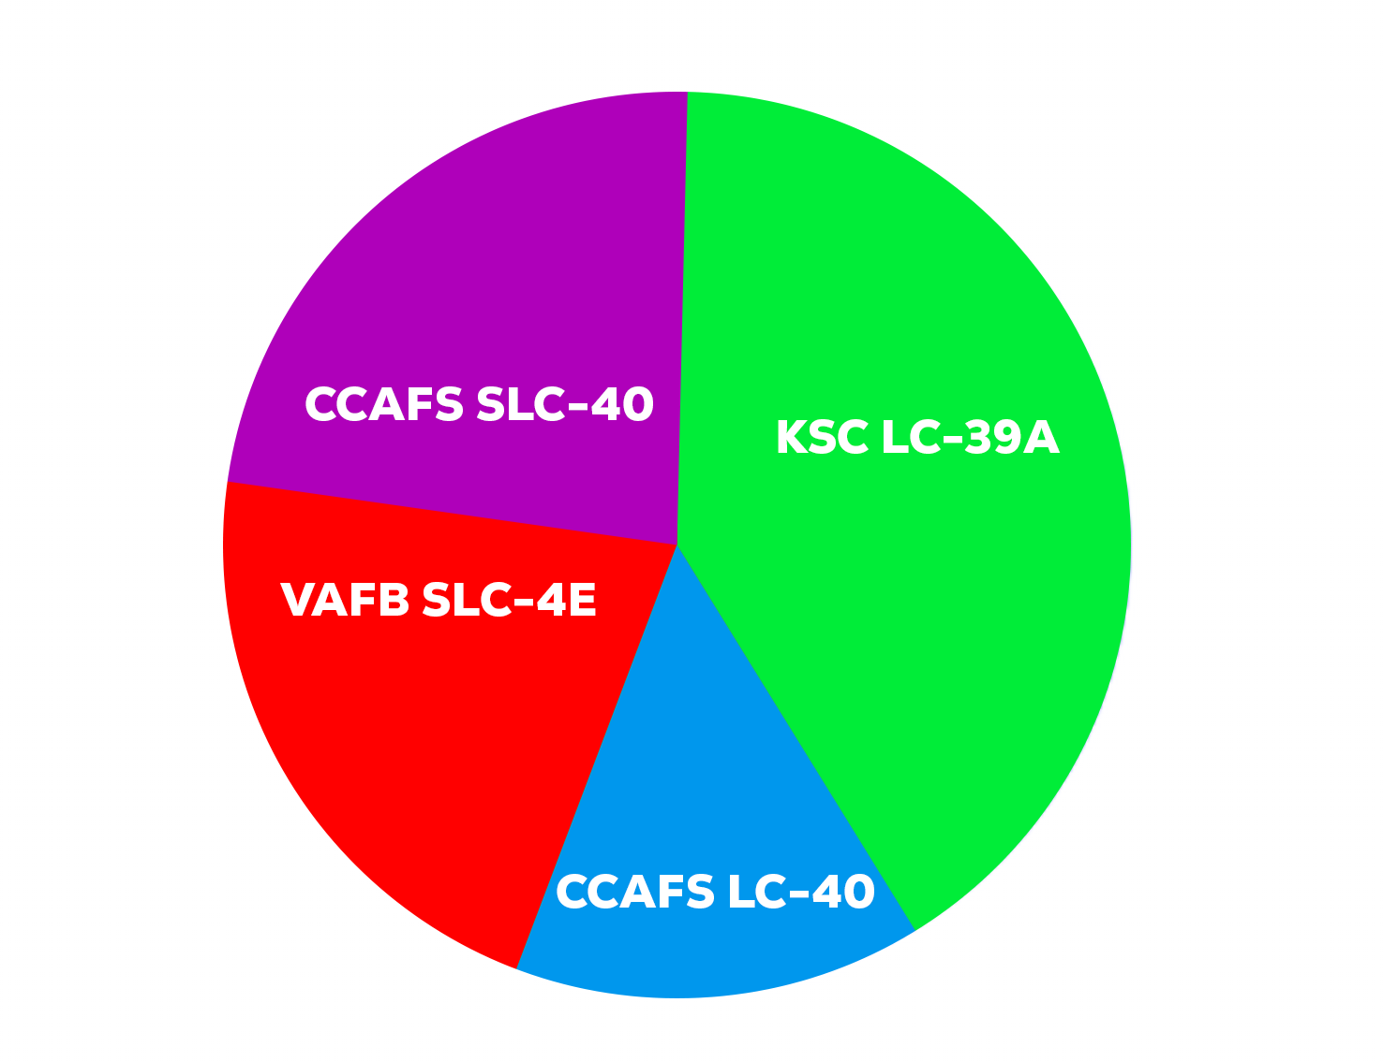
Representing Launch Success
The pie chart below demonstrates that KSC LC-39A has experience the most successful launches out of all sites.

Slide 40
The Launch Site With The Highest Launch Success Ratio
KSC LC-39A proved the highest launch success rate at 76.9%, with 10 successful landings and only 3 failures.

Slide 41
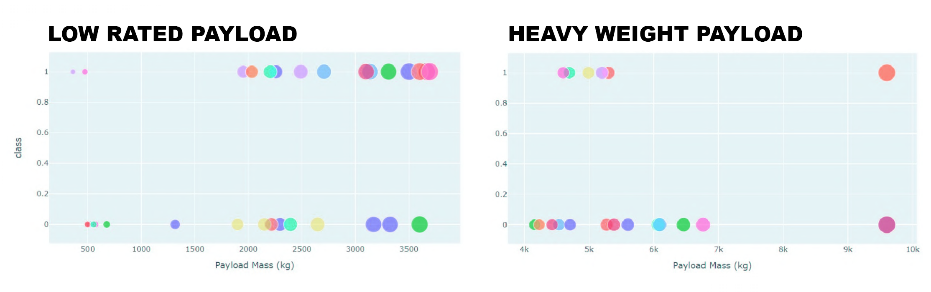
Scatter Plot – Payload vs Launch Outcome
We can see from the scatter graphs below that the success rate for low-weighted-payload is higher vs the heavy-weighted-payload.

Slide 42
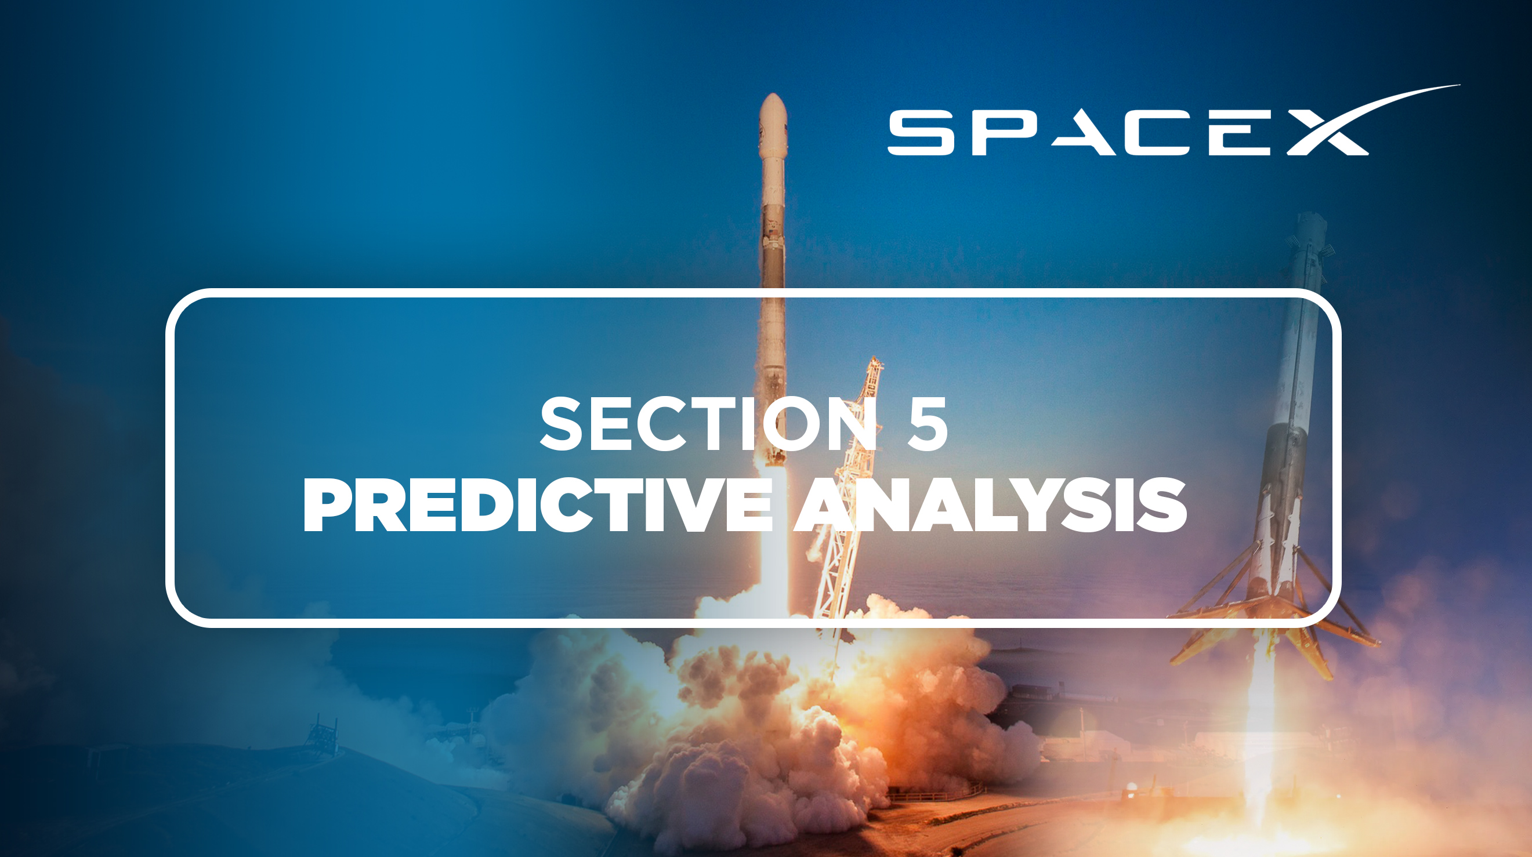

Slide 43
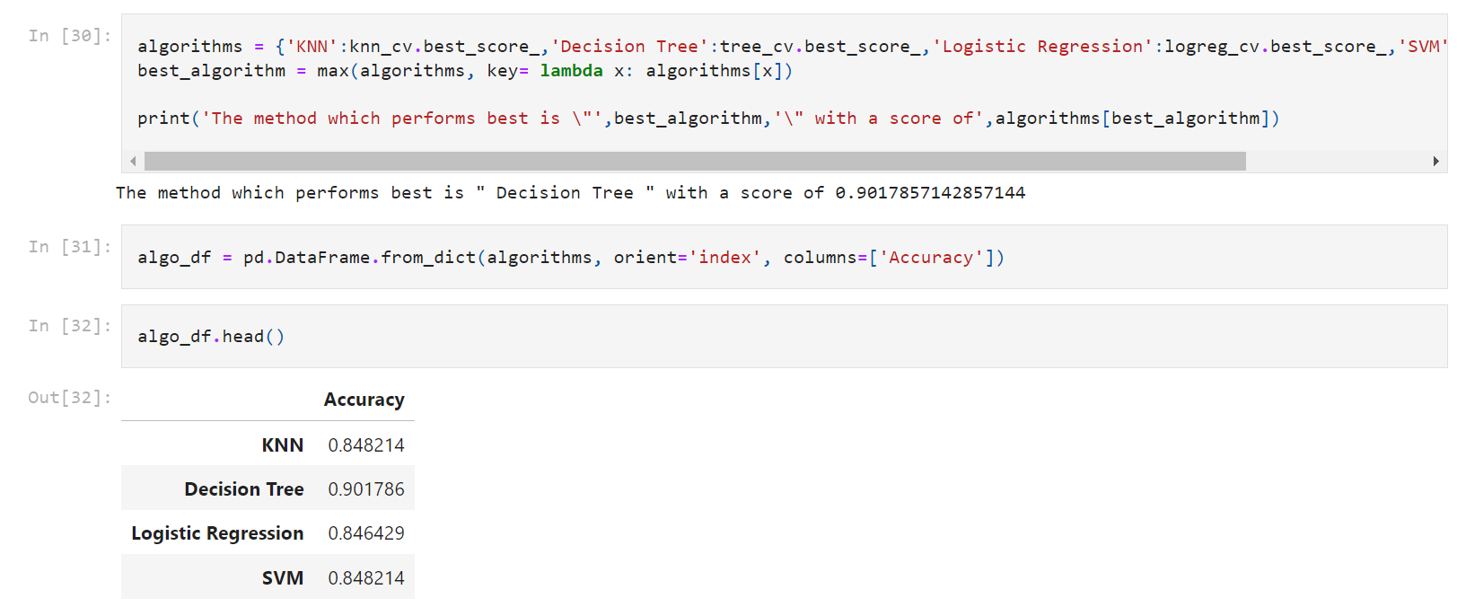
Classification Accuracy
As demonstrated by the code below, I identified the “Decision Tree” Algorithm as the best algorithm due to its highest classification accuracy.

Slide 44
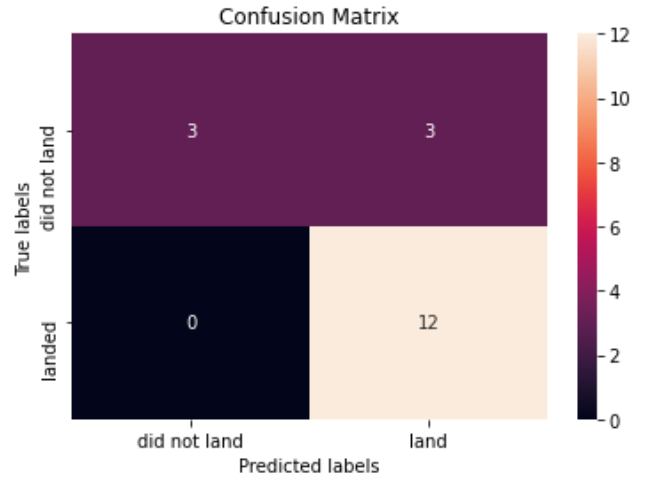
Confusion Matrix
Analysing the confusion matrix reveals that logistic regression effectively differentiates between the classes. However, the primary issue lies with the high number of false positives.

Slide 45
Conclusions
The Decision Tree Model is the best algorithm for this dataset.
The success rate of launches has increased over the years.
KSC LC-39A has the highest success rate among all launch sites.
Lower-weight payloads (defined as 4000kg and below) performed better than heavier payloads.
Most launch sites are near the Equator and all are in close proximity to the coast.
Analysing the confusion matrix reveals that logistic regression effectively differentiates between the classes. However, the primary issue lies with the high number of false positives.
Orbits ES-L1, GEO, HEO and SSO have the best success rates.

Slide 46


